Slide 1


Group 1 Assignment 3
Server and Client monitoring

Slide 2
Team Name: DRR Members: Dan Jones Rick Replogle Ryan Williams

Slide 3
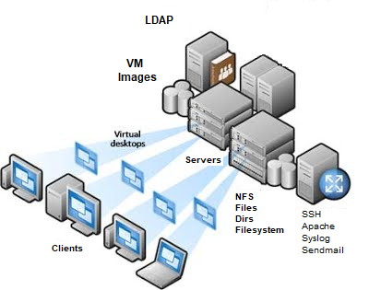
Benefits of Server and Client Monitoring
Early detection of problems
Real-time Notifications
Performance Monitoring
Fix performance issues and downtime quickly
Improve reliability of system resources
Systems will have a higher uptime
Better End-User experience
Company wide monitoring if System Services
Systems Administrators can be better aware of all critical systems on Server and Client computers throughout the company

Slide 4

Server and Client Configuration With

Slide 5
What is Monit?
Monit is a small Open Source utility for managing and monitoring daemons (and similar processes), files and directories and filesystems and devices running on Linux systems.
Monit is easy to install and configure and can be up and running in minutes with all the features needed for system and client monitoring throughout your company
Monit conducts automatic maintenance and repair and can take actions for error recovery situations.
Monit will start specified programs if they are not running or restartes them when they are responding
Monit has a clean, sinple design and user interface that scales well whether you a few hosts or thousands of hosts.
They say it is like having a watchdog with a toolbox on your server.

Slide 6
Monit Configuration
What can you monitor:
Processes like the ones started at system boot time:
Apache, SSH, Syslog, Sendmail
Files, Directories and Filesystems:
Files changes, Disk capacity changes
Services:
LDAP, NFS
CPU usage and Memory usages

Slide 7
Monit Implentation
Locate the script files online
# wget https://github.com/NKU-CIT-470/Project3/raw/main/a3.tar.bz2
Unzip the a3.tar.bz2 file to extract the shell script configuration files
# tar xvf a3.tar.bz2
Use the “./monit-client-install” script to start installation
# ./monit-client-install
Use the “./server_testing.sh” script to test the Monit configuration on the server
# ./monit_server_testing.sh
Use the “./client_testing.sh” script to test the Monit configuration on the clients
# ./monit_client_testing.sh

Slide 8

Conclusion:
This demonstration was about Installing Monit on server and client computers within your company
This was done USING Monit Configuration files and install scripts
Setting up monit shows how your company would benefit from the monitoring of critical server and client systems with automatic recovery and alerts of failures and automatic recovery of those systems
Monit can be easily customized to monitor many different types of systems and processes within your company

